Slide 1






Hasnain Mehdi Raza CMS ID: 345982
Salman Memon CMS ID: 333279
DESIGNING AUTOMATED PAVEMENT CONDITION RATING THROUGH COMPUTER VISION: A YOLOv8 APPROACH
School of Civil and Environmental Engineering (SCEE), National University of Sciences and Technology (NUST), Islamabad, Pakistan.
Arsalan CMS ID: 347095
Syed Irtaza Imam CMS ID: 339466

Slide 2
SEQUENCE
OUR TEAM
Introduction
Methodology
DESIGNING AUTOMATED PAVEMENT CONDITION RATING THROUGH COMPUTER VISION: A YOLOv8 APPROACH
Hasnain Mehdi Raza CMS ID: 345982
Salman Memon CMS ID: 333279
Literature Review
Arsalan CMS ID: 347095
Syed Irtaza Imam CMS ID: 339466
School of Civil and Environmental Engineering (SCEE), National University of Sciences and Technology (NUST), Islamabad, Pakistan.

Slide 3
OUR TEAM
SEQUENCE
Introduction
Methodology
Results
Conclusion
Hasnain Mehdi Raza CMS ID: 345982
Salman Memon CMS ID: 333279
Literature Review
Analysis
Arsalan CMS ID: 347095
Syed Irtaza Imam CMS ID: 339466
3
School of Civil and Environmental Engineering (SCEE), National University of Sciences and Technology (NUST), Islamabad, Pakistan
School of Civil and Environmental Engineering (SCEE), National University of Sciences and Technology (NUST), Islamabad, Pakistan
Designing Automated Pavement Condition Rating Through Computer Vision: A YOLOv8 Approach

Slide 4
Introduction
Literature Review
Methodology
Results & Analysis
Conclusion
SEQUENCE
SEQUENCE OF PRESENTATION
Introduction
Methodology
Results
Conclusion
Literature Review
Analysis
3
School of Civil and Environmental Engineering (SCEE), National University of Sciences and Technology (NUST), Islamabad, Pakistan
School of Civil and Environmental Engineering (SCEE), National University of Sciences and Technology (NUST), Islamabad, Pakistan
Designing Automated Pavement Condition Rating Through Computer Vision: A YOLOv8 Approach

Slide 5
SEQUENCE
Results
Conclusion
Analysis
Introduction
Literature Review
Methodology
Results & Analysis
Conclusion
Importance of Road Infrastructure
Critical Role in Societal Connectivity
Impact on Economy
Around 20% of Annual Public Sector Development Program’s Budget
4
School of Civil and Environmental Engineering (SCEE), National University of Sciences and Technology (NUST), Islamabad, Pakistan
3
School of Civil and Environmental Engineering (SCEE), National University of Sciences and Technology (NUST), Islamabad, Pakistan
Designing Automated Pavement Condition Rating Through Computer Vision: A YOLOv8 Approach
School of Civil and Environmental Engineering (SCEE), National University of Sciences and Technology (NUST), Islamabad, Pakistan

Slide 6


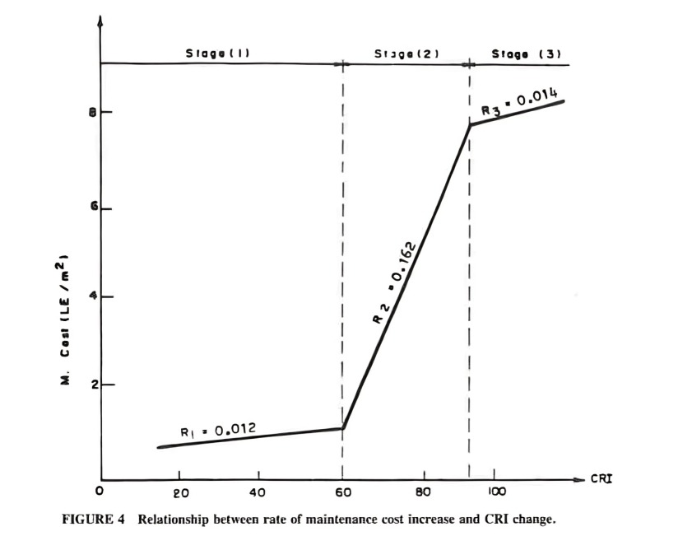
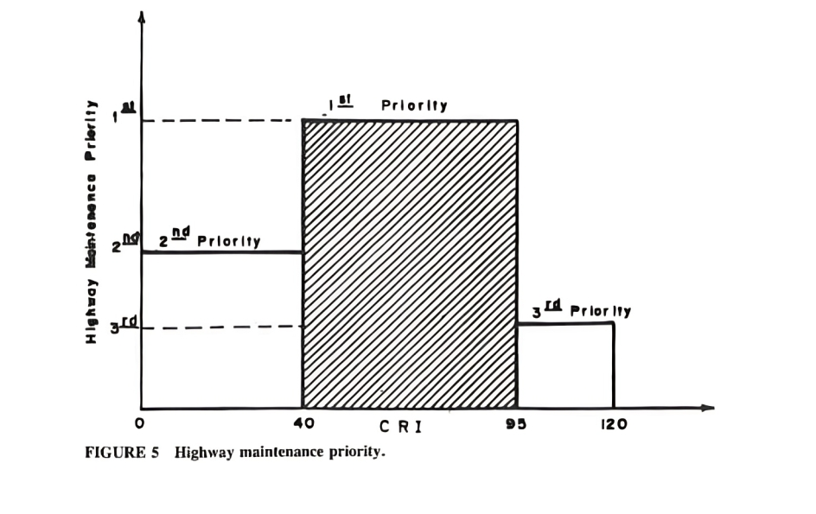
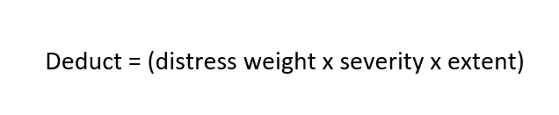
Introduction
Literature Review
Methodology
Results & Analysis
Conclusion
Pavement Condition Rating
Used to evaluate road health
PCR used by FHWA
Evaluate various distresses, their severity, and extent.
DECISION MAKING
Strategic Significance of PCR
Co-relation with Cost
Helpful for Resource Allocation
PRIORITIES, BUDGET NEEDS, PROGRAMS& OPTIMIZATION
PAVEMENT PERFORMANCE
PMS
PAVEMENT CONDITION ANALYSIS
FRICTION
STRUCTURE
DISTRESS
RIDE
PAVEMENT CONDITION – DATA COLLECTION
5
School of Civil and Environmental Engineering (SCEE), National University of Sciences and Technology (NUST), Islamabad, Pakistan
3
School of Civil and Environmental Engineering (SCEE), National University of Sciences and Technology (NUST), Islamabad, Pakistan
Designing Automated Pavement Condition Rating Through Computer Vision: A YOLOv8 Approach
School of Civil and Environmental Engineering (SCEE), National University of Sciences and Technology (NUST), Islamabad, Pakistan

Slide 7
Introduction
Literature Review
Methodology
Results & Analysis
Conclusion
DECISION MAKING
PRIORITIES, BUDGET NEEDS, PROGRAMS& OPTIMIZATION
PAVEMENT PERFORMANCE
PMS
PAVEMENT CONDITION ANALYSIS
FRICTION
STRUCTURE
DISTRESS
RIDE
PAVEMENT CONDITION – DATA COLLECTION
6
School of Civil and Environmental Engineering (SCEE), National University of Sciences and Technology (NUST), Islamabad, Pakistan
School of Civil and Environmental Engineering (SCEE), National University of Sciences and Technology (NUST), Islamabad, Pakistan
Designing Automated Pavement Condition Rating Through Computer Vision: A YOLOv8 Approach

Slide 8
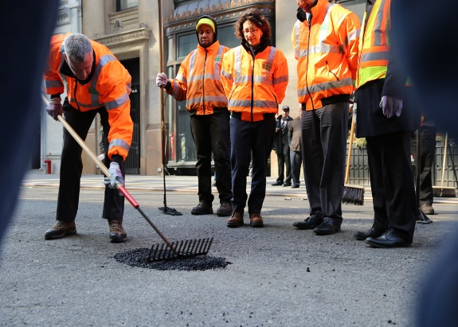
Introduction
Literature Review
Methodology
Results & Analysis
Conclusion
Importance of Road Infrastructure
Critical Role in Societal Connectivity
Impact on Economy
Strategic Significance of PCR
Co-relation with Cost
Helpful for Resource Allocation
Impact of Pavement Distresses
Challenge to Road Safety
Degradation of Road Health
Pavement Condition Rating
Evaluate various distresses, their severity, and extent.
Transport Research International Documentation – A Simplified Pavement Maintenance Model
7
School of Civil and Environmental Engineering (SCEE), National University of Sciences and Technology (NUST), Islamabad, Pakistan
School of Civil and Environmental Engineering (SCEE), National University of Sciences and Technology (NUST), Islamabad, Pakistan
Designing Automated Pavement Condition Rating Through Computer Vision: A YOLOv8 Approach

Slide 9
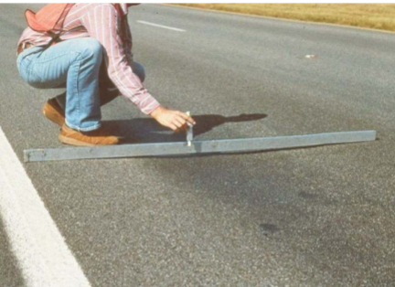

PROBLEM STATEMENT
Introduction
Literature Review
Methodology
Results & Analysis
Conclusion
Inefficiency in Current Solutions:
Manual Road Damage Identification
Limited Road Data Detail
Opportunity for AI-Driven Solutions:
Enhancing Efficiency and Reducing Costs
Focus on Safety and Intelligent Transportation Systems
8
School of Civil and Environmental Engineering (SCEE), National University of Sciences and Technology (NUST), Islamabad, Pakistan
3
School of Civil and Environmental Engineering (SCEE), National University of Sciences and Technology (NUST), Islamabad, Pakistan
Designing Automated Pavement Condition Rating Through Computer Vision: A YOLOv8 Approach
School of Civil and Environmental Engineering (SCEE), National University of Sciences and Technology (NUST), Islamabad, Pakistan

Slide 10

Introduction
Literature Review
Methodology
Results & Analysis
Conclusion
Introduction
Literature Review
Methodology
Results & Analysis
Conclusion
Author | Year | Outcomes
Abdualmtalab Abdualaziz Ali | September 2023 | The PCI model is weak with block and transverse cracking and has no correlation with potholes.
Cuthbert Ruseruka | April 2023 | This paper showed that different CAN sensors could be used to predict the pavement distresses with high accuracy
9
School of Civil and Environmental Engineering (SCEE), National University of Sciences and Technology (NUST), Islamabad, Pakistan
3
School of Civil and Environmental Engineering (SCEE), National University of Sciences and Technology (NUST), Islamabad, Pakistan
Designing Automated Pavement Condition Rating Through Computer Vision: A YOLOv8 Approach
School of Civil and Environmental Engineering (SCEE), National University of Sciences and Technology (NUST), Islamabad, Pakistan

Slide 11
Research Gap
Introduction
Literature Review
Methodology
Results & Analysis
Conclusion
PCR Calculation ☑
A.A.Ali, 2023
PCR Calculation ☑
Waqar.S.Qureshi,2023
PCR Calculation ☑
Saúl Cano-Ortiz, 2024
PCR Calculation ☒
Distress Identification ☑
Distress Identification ☒
Distress Identification ☒
Our Research
Distress Identification ☑
Author | Year | Outcomes
Waqar S. Qureshi | September 2023 | Deep learning framework for automated PCR for regional and local roads
Saúl Cano-Ortiz | February 2023 | The refined optimal model is subjected to evaluation against diverse open datasets to assess its generalization.
9
School of Civil and Environmental Engineering (SCEE), National University of Sciences and Technology (NUST), Islamabad, Pakistan
3
School of Civil and Environmental Engineering (SCEE), National University of Sciences and Technology (NUST), Islamabad, Pakistan
Designing Automated Pavement Condition Rating Through Computer Vision: A YOLOv8 Approach
School of Civil and Environmental Engineering (SCEE), National University of Sciences and Technology (NUST), Islamabad, Pakistan

Slide 12
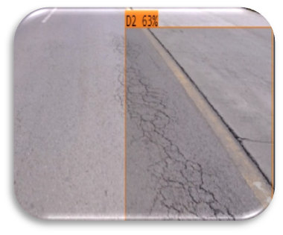
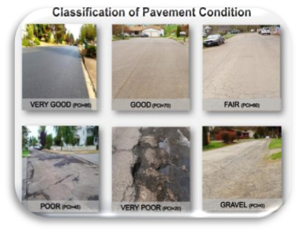
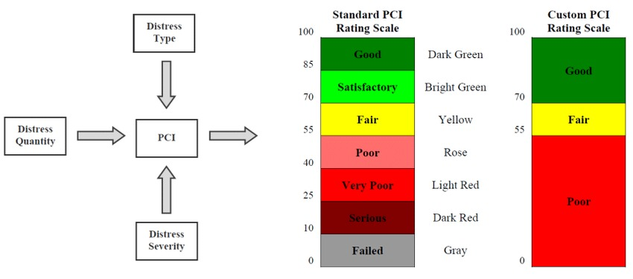
RESEARCH GAP
Introduction
Literature Review
Methodology
Results & Analysis
Conclusion
PCR Calculation ☑
A.A.Ali, 2023
PCR Calculation ☑
Waqar.S.Qureshi,2023
PCR Calculation ☑
Saúl Cano-Ortiz, 2024
PCR Calculation ☒
Distress Identification ☑
Distress Identification ☒
Distress Identification ☒
Our Research
Distress Identification ☑
Author | Year | Outcomes
Waqar S. Qureshi | September 2023 | Deep learning framework for automated PCR for regional and local roads
Saúl Cano-Ortiz | February 2023 | The refined optimal model is subjected to evaluation against diverse open datasets to assess its generalization.
10
School of Civil and Environmental Engineering (SCEE), National University of Sciences and Technology (NUST), Islamabad, Pakistan
3
School of Civil and Environmental Engineering (SCEE), National University of Sciences and Technology (NUST), Islamabad, Pakistan
Designing Automated Pavement Condition Rating Through Computer Vision: A YOLOv8 Approach
School of Civil and Environmental Engineering (SCEE), National University of Sciences and Technology (NUST), Islamabad, Pakistan

Slide 13


OBJECTIVES
Introduction
Literature Review
Methodology
Results & Analysis
Conclusion
Introduction
Literature Review
Methodology
Results & Analysis
Conclusion
To establish a mechanism that will detect pavement distresses using AI (YOLOv8)
To classify distresses according to the standards of FHWA
To calculate Pavement Condition Rating
11
School of Civil and Environmental Engineering (SCEE), National University of Sciences and Technology (NUST), Islamabad, Pakistan
3
School of Civil and Environmental Engineering (SCEE), National University of Sciences and Technology (NUST), Islamabad, Pakistan
Designing Automated Pavement Condition Rating Through Computer Vision: A YOLOv8 Approach
School of Civil and Environmental Engineering (SCEE), National University of Sciences and Technology (NUST), Islamabad, Pakistan

Slide 14
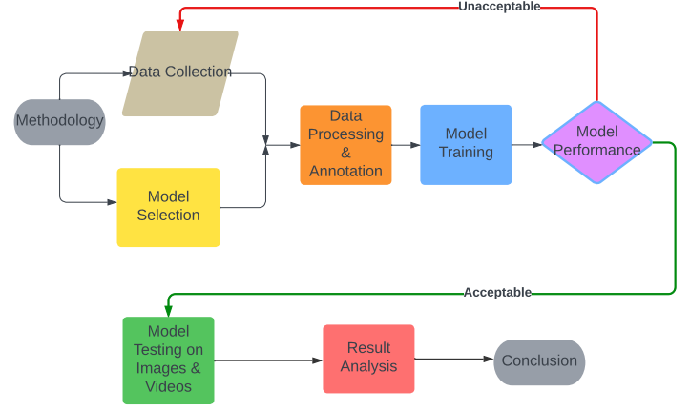
Introduction
Literature Review
Methodology
Results & Analysis
Conclusion
Introduction
Literature Review
Methodology
Results & Analysis
Conclusion
Data Annotation
Data Collection
Pavement
Condition
Rating
01 – Data Collection
02 – Pavement Condition Rating
05 – Model Testing
Model Testing
Model Training
03 – Data Preprocessing
04 – Model Training
12
School of Civil and Environmental Engineering (SCEE), National University of Sciences and Technology (NUST), Islamabad, Pakistan
3
School of Civil and Environmental Engineering (SCEE), National University of Sciences and Technology (NUST), Islamabad, Pakistan
Designing Automated Pavement Condition Rating Through Computer Vision: A YOLOv8 Approach
School of Civil and Environmental Engineering (SCEE), National University of Sciences and Technology (NUST), Islamabad, Pakistan

Slide 15



Introduction
Literature Review
Methodology
Results & Analysis
Conclusion
Data Collection:
Diverse Dataset gathered from:
National Highway Authority (NHA).
Self-collection.
7062 Images.
Has various road distresses, including cracks, patches, and potholes.
Data Annotation
Data Collection
Pavement
Condition
Rating
01 – Data Collection
02 – Pavement Condition Rating
05
05 – Model Testing
Model Testing
02
Model Training
03 – Data Preprocessing
04 – Model Training
13
School of Civil and Environmental Engineering (SCEE), National University of Sciences and Technology (NUST), Islamabad, Pakistan
School of Civil and Environmental Engineering (SCEE), National University of Sciences and Technology (NUST), Islamabad, Pakistan
Designing Automated Pavement Condition Rating Through Computer Vision: A YOLOv8 Approach
Notes:
© Copyright PresentationGO.com – Free Templates & Infographics for PowerPoint and Google Slides

Slide 16
Introduction
Literature Review
Methodology
Results & Analysis
Conclusion
Data Collection:
Diverse Dataset gathered from:
National Highway Authority (NHA).
Self-collection.
7062 Images.
Has various road distresses, including cracks, patches, and potholes.
Data Annotation
Data Collection
Pavement
Condition
Rating
Model Testing
Model Training
13
School of Civil and Environmental Engineering (SCEE), National University of Sciences and Technology (NUST), Islamabad, Pakistan
School of Civil and Environmental Engineering (SCEE), National University of Sciences and Technology (NUST), Islamabad, Pakistan
Designing Automated Pavement Condition Rating Through Computer Vision: A YOLOv8 Approach
Notes:
© Copyright PresentationGO.com – Free Templates & Infographics for PowerPoint and Google Slides

Slide 17
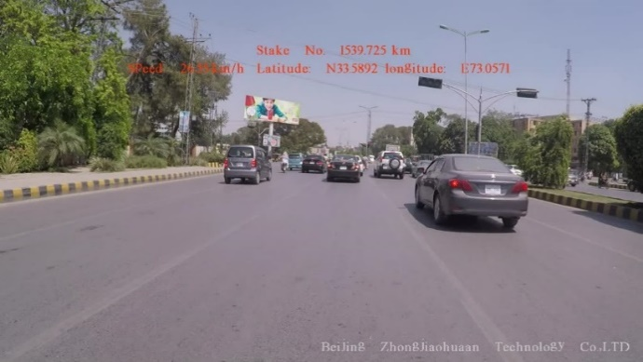
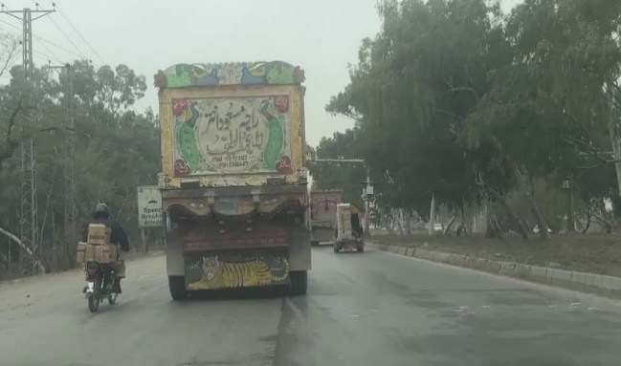
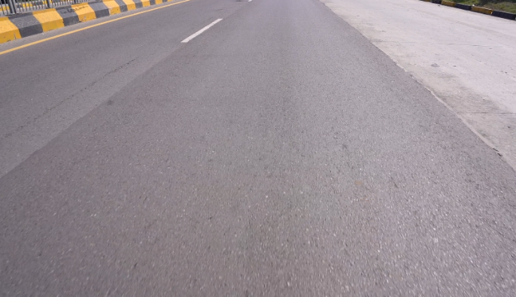
Introduction
Literature Review
Methodology
Results & Analysis
Conclusion
1934 Images
From NHA
Pavement Condition Rating:
Identified the distresses in the dataset
Classified according to the standards into 10 classes.
Data Annotation
Data Collection
Pavement
Condition
Rating
3621 Images
From Self Collection
Block Cracking | Alligator Cracking | Diagonal Cracking | Longitudinal Cracking
Random Cracking | Transversal Cracking | Longitudinal Cracking Between Lanes | Patching
Potholes | Raveling
Model Testing
05
Model Training
7062 Images
From Self Collection
14
School of Civil and Environmental Engineering (SCEE), National University of Sciences and Technology (NUST), Islamabad, Pakistan
School of Civil and Environmental Engineering (SCEE), National University of Sciences and Technology (NUST), Islamabad, Pakistan
Designing Automated Pavement Condition Rating Through Computer Vision: A YOLOv8 Approach
Notes:
© Copyright PresentationGO.com – Free Templates & Infographics for PowerPoint and Google Slides

Slide 18
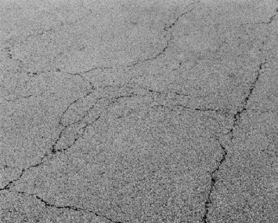
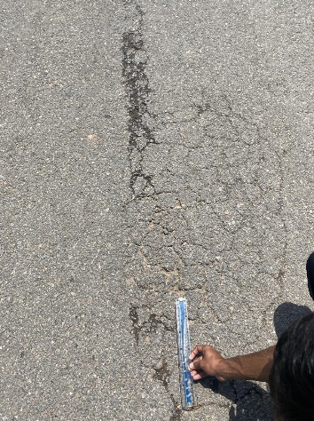
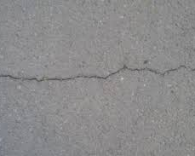
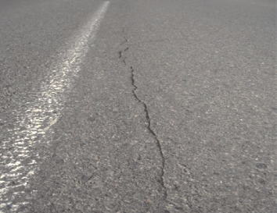
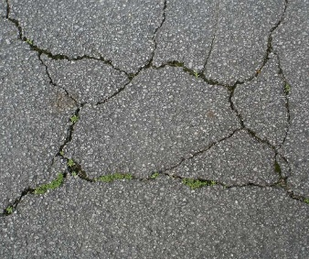
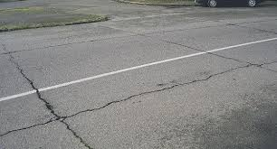
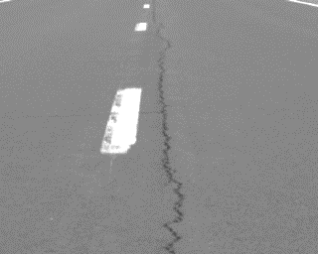
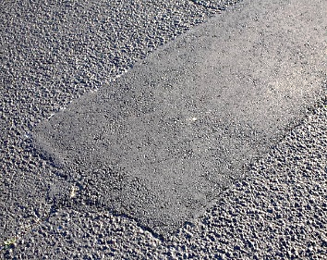
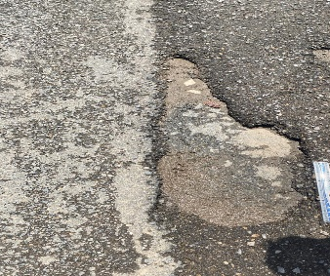
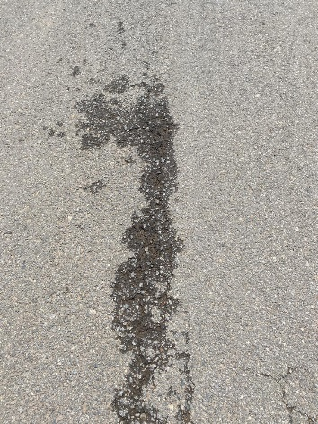
Introduction
Literature Review
Methodology
Results & Analysis
Conclusion
Pavement Condition Rating:
Identified the distresses in the dataset
Classified according to the standards into 10 classes.
Block Cracking
Alligator Cracking
Diagonal Cracking
Longitudinal Cracking
Data Annotation
Data Collection
Pavement
Condition
Rating
Block Cracking | Alligator Cracking | Diagonal Cracking | Longitudinal Cracking
Random Cracking | Transversal Cracking | Longitudinal Cracking Between Lanes | Patching
Potholes | Raveling
05
Random Cracking
Transversal Cracking
Longitudinal Cracking Between Lanes
Patching
Model Testing
Model Training
Potholes
Raveling
15
School of Civil and Environmental Engineering (SCEE), National University of Sciences and Technology (NUST), Islamabad, Pakistan
School of Civil and Environmental Engineering (SCEE), National University of Sciences and Technology (NUST), Islamabad, Pakistan
Designing Automated Pavement Condition Rating Through Computer Vision: A YOLOv8 Approach
Notes:
© Copyright PresentationGO.com – Free Templates & Infographics for PowerPoint and Google Slides

Slide 19
Introduction
Literature Review
Methodology
Results & Analysis
Conclusion
Block Cracking
Alligator Cracking
Diagonal Cracking
Longitudinal Cracking
Data Annotation
Data Collection
Pavement
Condition
Rating
05
Random Cracking
Transversal Cracking
Longitudinal Cracking Between Lanes
Patching
Model Testing
Model Training
Potholes
Raveling
16
School of Civil and Environmental Engineering (SCEE), National University of Sciences and Technology (NUST), Islamabad, Pakistan
School of Civil and Environmental Engineering (SCEE), National University of Sciences and Technology (NUST), Islamabad, Pakistan
Designing Automated Pavement Condition Rating Through Computer Vision: A YOLOv8 Approach
Notes:
© Copyright PresentationGO.com – Free Templates & Infographics for PowerPoint and Google Slides

Slide 20
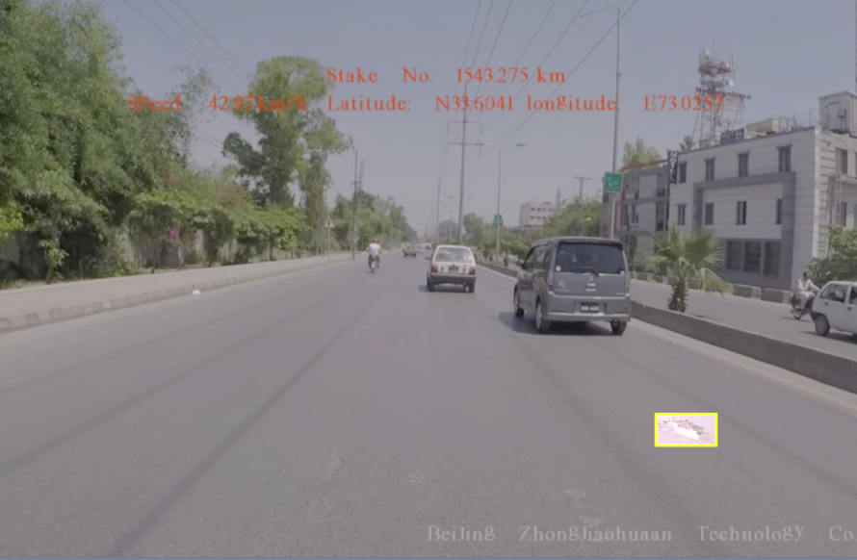
Introduction
Literature Review
Methodology
Results & Analysis
Conclusion
Data Preprocessing
Accurate Annotation.
Most Important for Training the Model.
Labeling in YOLO Format
Separated into:
70% Train, 15% Valid
15% Test
Machine-Learning Model Training:
Successfully Integrated and Developed the Model
Trained the Model for Utilizing the Dataset
Data Annotation
Data Collection
Pavement
Condition
Rating
05
Model Testing
17
School of Civil and Environmental Engineering (SCEE), National University of Sciences and Technology (NUST), Islamabad, Pakistan
Model Training
School of Civil and Environmental Engineering (SCEE), National University of Sciences and Technology (NUST), Islamabad, Pakistan
Designing Automated Pavement Condition Rating Through Computer Vision: A YOLOv8 Approach
Notes:
© Copyright PresentationGO.com – Free Templates & Infographics for PowerPoint and Google Slides

Slide 21
Introduction
Literature Review
Methodology
Results & Analysis
Conclusion
Precision Testing
Tested the Model on:
Images (JPEG)
Videos (MP4)
Compared the Results To Manual Calculations
Machine-Learning Model Training:
Successfully Integrated and Developed the Model
Trained the Model for Utilizing the Dataset
Data Annotation
Data Collection
Pavement
Condition
Rating
05
Model Testing
Model Training
18
School of Civil and Environmental Engineering (SCEE), National University of Sciences and Technology (NUST), Islamabad, Pakistan
School of Civil and Environmental Engineering (SCEE), National University of Sciences and Technology (NUST), Islamabad, Pakistan
Designing Automated Pavement Condition Rating Through Computer Vision: A YOLOv8 Approach
Notes:
© Copyright PresentationGO.com – Free Templates & Infographics for PowerPoint and Google Slides

Slide 22
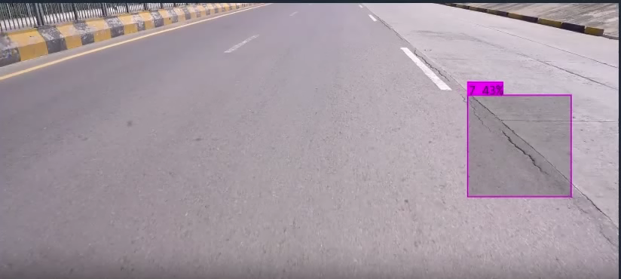
Introduction
Literature Review
Methodology
Results & Analysis
Conclusion
Precision Testing
Tested the Model on:
Images (JPEG)
Videos (MP4)
Compared the Results To Manual Calculations
Data Annotation
Data Collection
Pavement
Condition
Rating
05
Model Testing
Model Training
PCR = 81.4
19
School of Civil and Environmental Engineering (SCEE), National University of Sciences and Technology (NUST), Islamabad, Pakistan
School of Civil and Environmental Engineering (SCEE), National University of Sciences and Technology (NUST), Islamabad, Pakistan
Designing Automated Pavement Condition Rating Through Computer Vision: A YOLOv8 Approach
Notes:
© Copyright PresentationGO.com – Free Templates & Infographics for PowerPoint and Google Slides

Slide 23
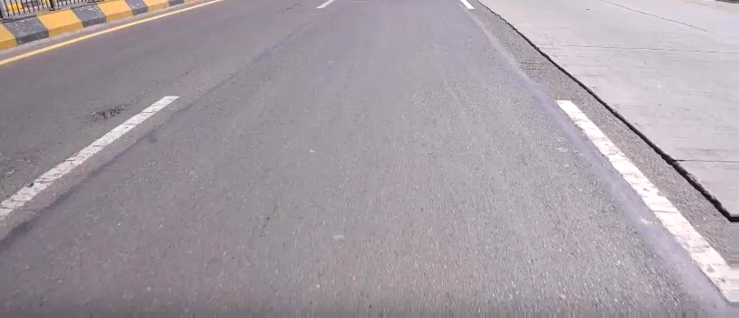
Introduction
Literature Review
Methodology
Results & Analysis
Conclusion
PCR = 81.4
20
School of Civil and Environmental Engineering (SCEE), National University of Sciences and Technology (NUST), Islamabad, Pakistan
School of Civil and Environmental Engineering (SCEE), National University of Sciences and Technology (NUST), Islamabad, Pakistan
Designing Automated Pavement Condition Rating Through Computer Vision: A YOLOv8 Approach
Notes:
© Copyright PresentationGO.com – Free Templates & Infographics for PowerPoint and Google Slides

Slide 24

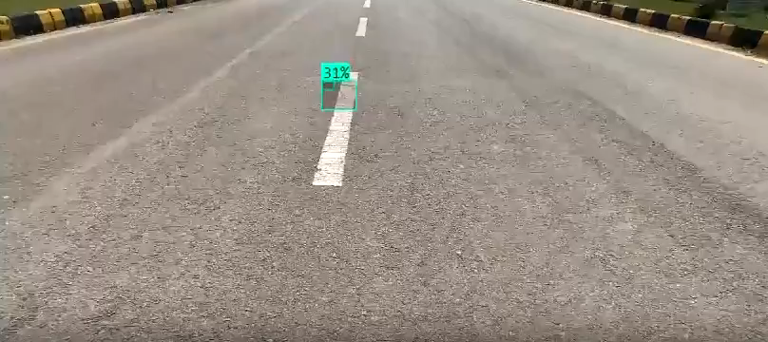
Introduction
Literature Review
Methodology
Results & Analysis
Conclusion
PCR = 82.1
20
School of Civil and Environmental Engineering (SCEE), National University of Sciences and Technology (NUST), Islamabad, Pakistan
School of Civil and Environmental Engineering (SCEE), National University of Sciences and Technology (NUST), Islamabad, Pakistan
Designing Automated Pavement Condition Rating Through Computer Vision: A YOLOv8 Approach
Notes:
© Copyright PresentationGO.com – Free Templates & Infographics for PowerPoint and Google Slides

Slide 25
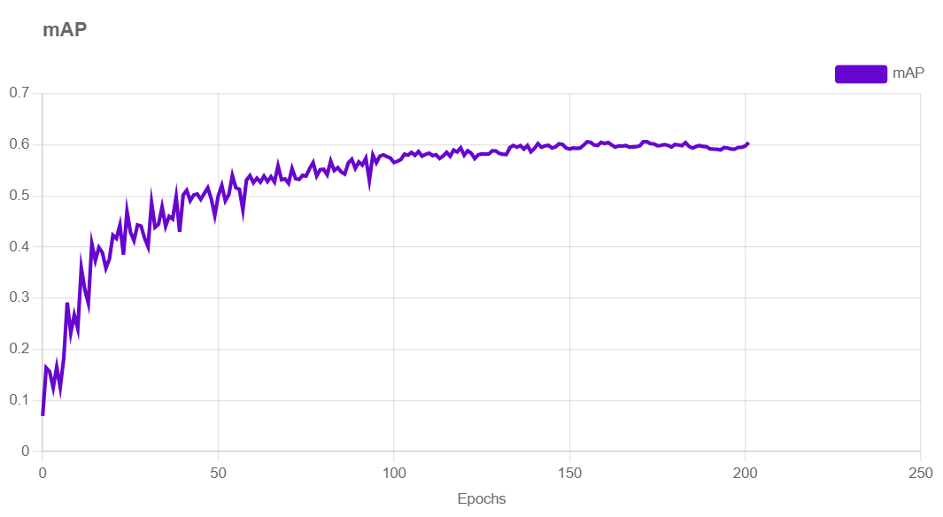
Introduction
Literature Review
Methodology
Results & Analysis
Conclusion
PCR = 58.65
21
School of Civil and Environmental Engineering (SCEE), National University of Sciences and Technology (NUST), Islamabad, Pakistan
School of Civil and Environmental Engineering (SCEE), National University of Sciences and Technology (NUST), Islamabad, Pakistan
Designing Automated Pavement Condition Rating Through Computer Vision: A YOLOv8 Approach
Notes:
© Copyright PresentationGO.com – Free Templates & Infographics for PowerPoint and Google Slides

Slide 26
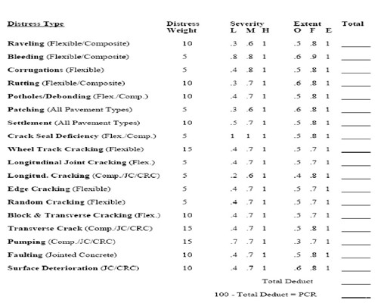
Introduction
Literature Review
Methodology
Results & Analysis
Conclusion
Results:
The Model showed mean average precision of 60%
22
School of Civil and Environmental Engineering (SCEE), National University of Sciences and Technology (NUST), Islamabad, Pakistan
School of Civil and Environmental Engineering (SCEE), National University of Sciences and Technology (NUST), Islamabad, Pakistan
Designing Automated Pavement Condition Rating Through Computer Vision: A YOLOv8 Approach
Notes:
© Copyright PresentationGO.com – Free Templates & Infographics for PowerPoint and Google Slides

Slide 27
Introduction
Literature Review
Methodology
Results & Analysis
Conclusion
Implementation of PCR:
The use of confidence to determine severity
Counting number of objects in each class to determine extent.
Severity |  | Extent
Low | Confidence <50 | Occasional | Total<5
Medium | 50<Confidence<75 | Frequent | 5<Total<10
High | Confidence>75 | Extensive | Total>10
23
School of Civil and Environmental Engineering (SCEE), National University of Sciences and Technology (NUST), Islamabad, Pakistan
School of Civil and Environmental Engineering (SCEE), National University of Sciences and Technology (NUST), Islamabad, Pakistan
Designing Automated Pavement Condition Rating Through Computer Vision: A YOLOv8 Approach
Notes:
© Copyright PresentationGO.com – Free Templates & Infographics for PowerPoint and Google Slides

Slide 28
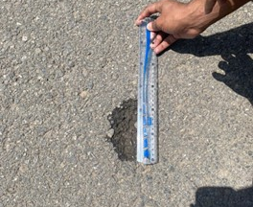
Introduction
Literature Review
Methodology
Results & Analysis
Conclusion
Defects | Confidence | Distress weight | Severity | Extent | Deduct
L. Cracking | 43 | 5 | 0.2 | 0.8 | 0.8
L. Joint | 40 | 5 | 0.4 | 0.5 | 1
Patching | 33 | 5 | 0.3 | 0.6 | 0.9
L. Cracking | 63 | 5 | 0.6 | 0.8 | 2.4
Patching | 47 | 5 | 0.3 | 0.6 | 0.9
L. Cracking | 24 | 5 | 0 | 0.8 | 0
Patching | 32 | 5 | 0.3 | 0.6 | 0.9
Random Cracking | 30 | 5 | 0.4 | 0.5 | 1
L. Cracking | 70 | 5 | 0.6 | 0.8 | 2.4
L. Cracking | 39 | 5 | 0.2 | 0.8 | 0.8
Random Cracking | 54 | 5 | 0.7 | 0.5 | 1.75
Raveling | 70 | 10 | 0.6 | 0.5 | 3
Random Cracking | 50 | 5 | 0.7 | 0.5 | 1.75
L. Cracking | 22 | 5 | 0 | 0.8 | 0
L. Joint | 38 | 5 | 0.4 | 0.5 | 1
 |  |  |  |  | 18.6
 |  |  | PCR | 81.4
PCR Comparison:
The difference is 13.04%
Criteria selection by varying confidence to determine severity
Criteria selection by varying number of objects detected in a patch to determine extent.
27
School of Civil and Environmental Engineering (SCEE), National University of Sciences and Technology (NUST), Islamabad, Pakistan
School of Civil and Environmental Engineering (SCEE), National University of Sciences and Technology (NUST), Islamabad, Pakistan
Designing Automated Pavement Condition Rating Through Computer Vision: A YOLOv8 Approach
Notes:
© Copyright PresentationGO.com – Free Templates & Infographics for PowerPoint and Google Slides

Slide 29
Introduction
Literature Review
Methodology
Results & Analysis
Conclusion
Defects | Confidence | Distress weight | Severity | Extent | Deduct
L. Cracking | 43 | 5 | 0.2 | 0.8 | 0.8
L. Joint | 40 | 5 | 0.4 | 0.5 | 1
Patching | 33 | 5 | 0.3 | 0.6 | 0.9
L. Cracking | 63 | 5 | 0.6 | 0.8 | 2.4
Patching | 47 | 5 | 0.3 | 0.6 | 0.9
L. Cracking | 24 | 5 | 0 | 0.8 | 0
Patching | 32 | 5 | 0.3 | 0.6 | 0.9
Random Cracking | 30 | 5 | 0.4 | 0.5 | 1
L. Cracking | 70 | 5 | 0.6 | 0.8 | 2.4
L. Cracking | 39 | 5 | 0.2 | 0.8 | 0.8
Random Cracking | 54 | 5 | 0.7 | 0.5 | 1.75
Raveling | 70 | 10 | 0.6 | 0.5 | 3
Random Cracking | 50 | 5 | 0.7 | 0.5 | 1.75
L. Cracking | 22 | 5 | 0 | 0.8 | 0
L. Joint | 38 | 5 | 0.4 | 0.5 | 1
 |  |  |  |  | 18.6
 |  |  | PCR | 81.4
PCR Comparison:
The difference is 13.04%
Conclusion:
The project efficiently detects different types of pavement distresses. (Objective: 1)
The model effectively categorized defects according to FHWA Standards of PCR. (Objective: 2)
The PCR values for different road patches were successfully computed. (Objective: 3)
28
School of Civil and Environmental Engineering (SCEE), National University of Sciences and Technology (NUST), Islamabad, Pakistan
School of Civil and Environmental Engineering (SCEE), National University of Sciences and Technology (NUST), Islamabad, Pakistan
Designing Automated Pavement Condition Rating Through Computer Vision: A YOLOv8 Approach
Notes:
© Copyright PresentationGO.com – Free Templates & Infographics for PowerPoint and Google Slides

Slide 30

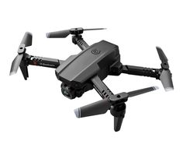
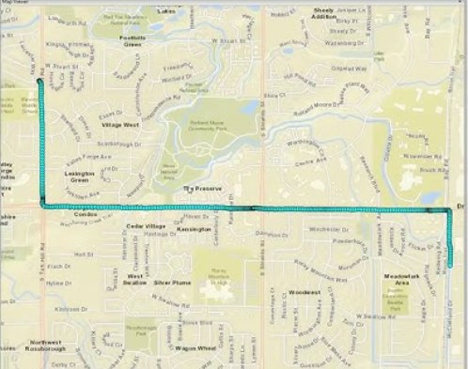
Introduction
Literature Review
Methodology
Results & Analysis
Conclusion
PCR Comparison:
The difference is 13.04%
Conclusion:
The project efficiently detects different types of pavement distresses. (Objective: 1)
The model effectively categorized defects according to FHWA Standards of PCR. (Objective: 2)
The use of LIDAR Sensor in addition with camera to detect distances accurately
The PCR values for different road patches were successfully computed. (Objective: 3)
29
School of Civil and Environmental Engineering (SCEE), National University of Sciences and Technology (NUST), Islamabad, Pakistan
School of Civil and Environmental Engineering (SCEE), National University of Sciences and Technology (NUST), Islamabad, Pakistan
Designing Automated Pavement Condition Rating Through Computer Vision: A YOLOv8 Approach
Notes:
© Copyright PresentationGO.com – Free Templates & Infographics for PowerPoint and Google Slides

Slide 31
Introduction
Literature Review
Methodology
Results & Analysis
Conclusion
The use of LIDAR Sensor in addition with camera to detect distances accurately
Geotagging a video will help georeferencing a video for more accurate results.
Use of Drones to reduce carbon footprint and promote sustainable infrastructure
30
School of Civil and Environmental Engineering (SCEE), National University of Sciences and Technology (NUST), Islamabad, Pakistan
School of Civil and Environmental Engineering (SCEE), National University of Sciences and Technology (NUST), Islamabad, Pakistan
Designing Automated Pavement Condition Rating Through Computer Vision: A YOLOv8 Approach
Notes:
© Copyright PresentationGO.com – Free Templates & Infographics for PowerPoint and Google Slides

Slide 32
Introduction
Literature Review
Methodology
Results & Analysis
Conclusion
THANKS
School of Civil and Environmental Engineering (SCEE), National University of Sciences and Technology (NUST), Islamabad, Pakistan
School of Civil and Environmental Engineering (SCEE), National University of Sciences and Technology (NUST), Islamabad, Pakistan
Designing Automated Pavement Condition Rating Through Computer Vision: A YOLOv8 Approach
Notes:
© Copyright PresentationGO.com – Free Templates & Infographics for PowerPoint and Google Slides

